Slide 1


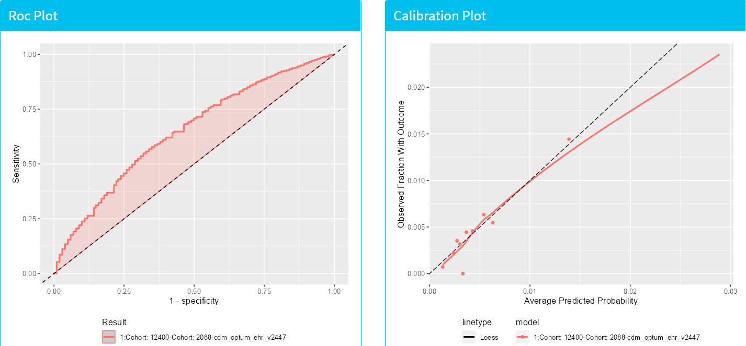
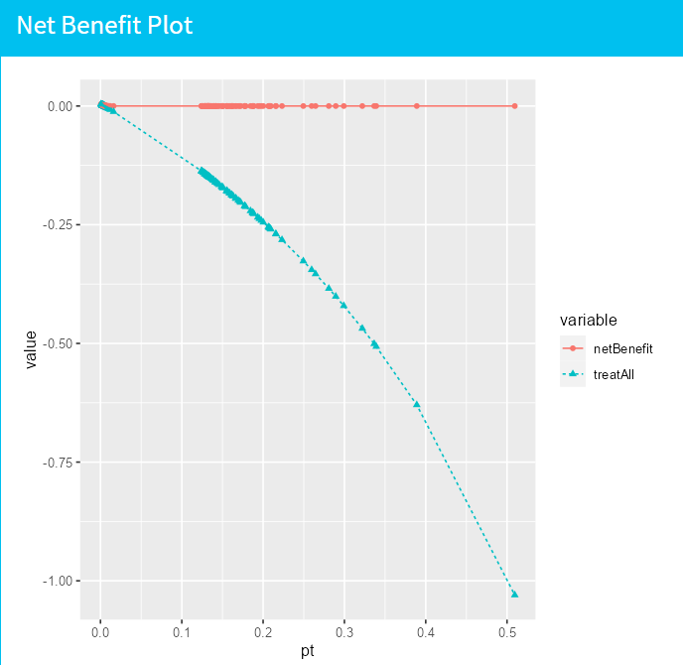
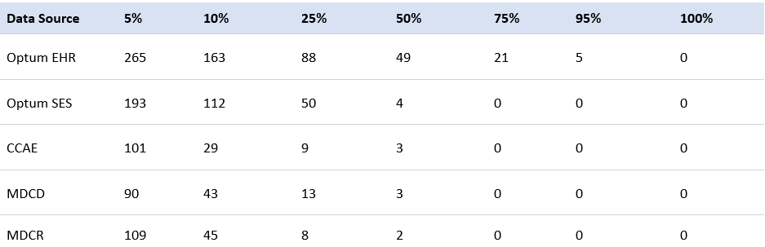
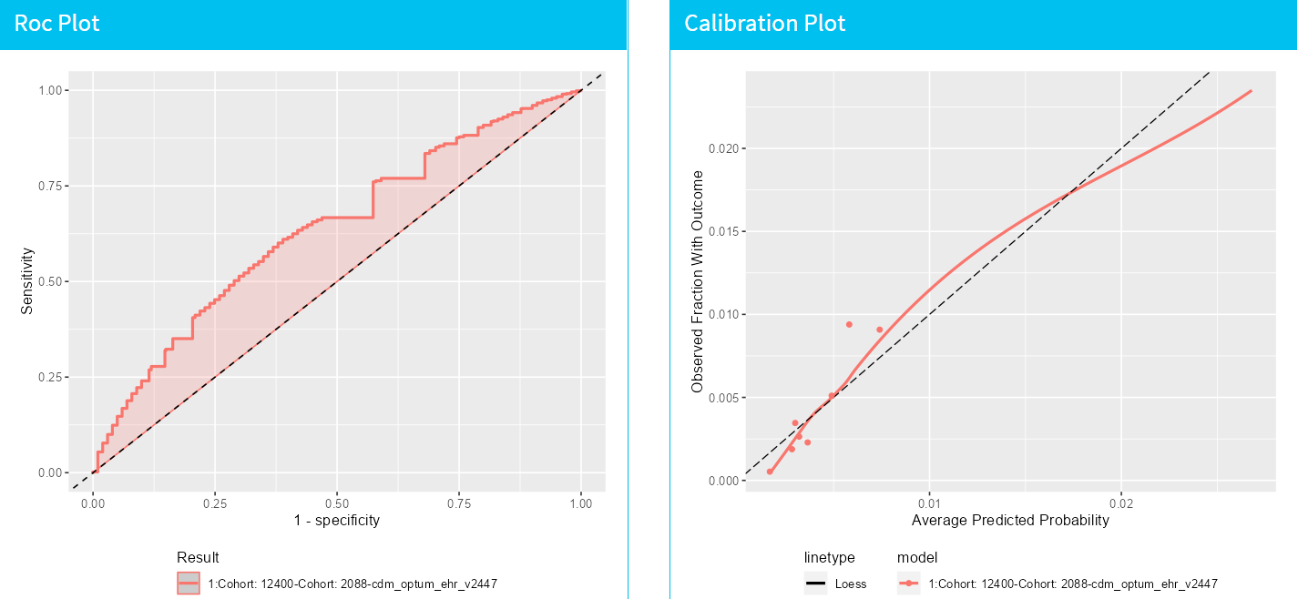
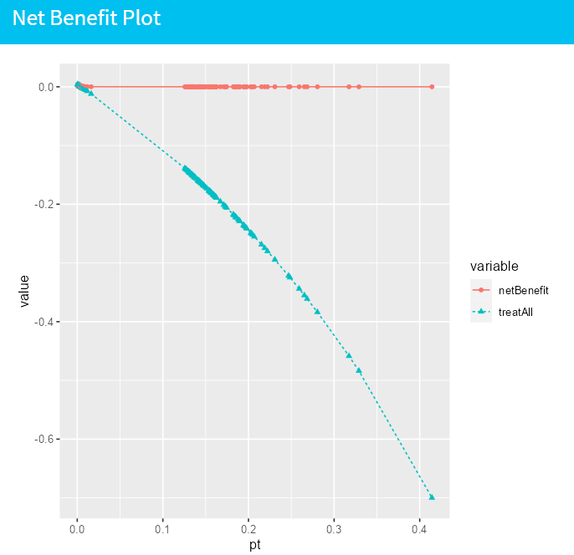

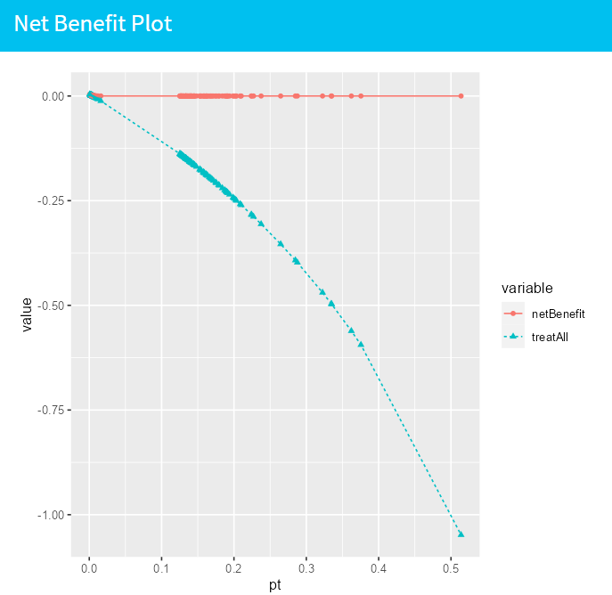
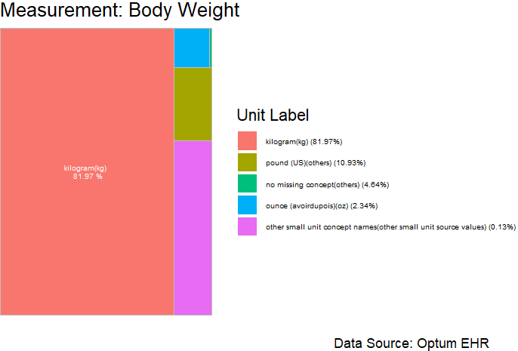
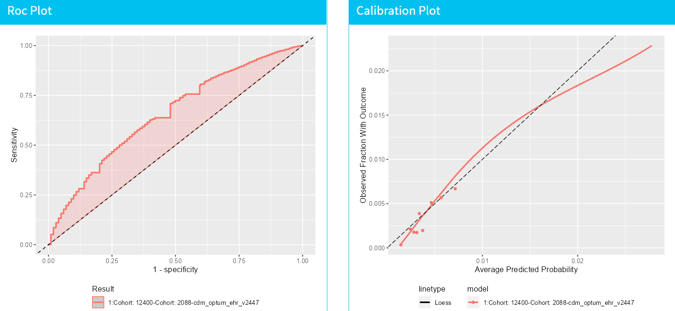
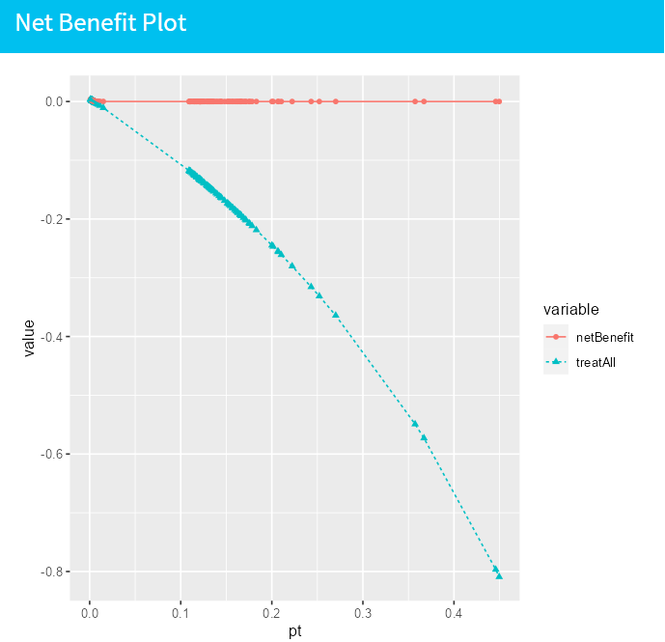
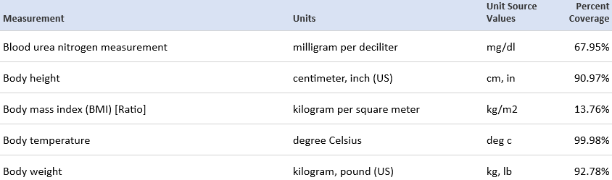

Real World Evidence Using Measurement Values for Patient -Level Prediction Models: a Feasibility Study
Xiaoyu Wang^{1,2}, Jenna Reps^{1,3}, Anthony Sena^{1,3}, James P. Gilbert¹, Marc A Suchard^{4,5}
¹Janssen Research and Development, Titusville, NJ, ²Statistical Science Department, Duke University, Durham, NC,
³Department of Medical Informatics, Erasmus University Medical Center, Rotterdam, the Netherlands
⁴VA Informatics and Computing Infrastructure, US Department of Veterans Affairs, Salt Lake City, UT
⁵Department of Biostatistics, University of California, Los Angeles, CA
ABSTRACT
METHODS
RESULTS
SUMMARY
The integration of measurements into patient-level prediction (PLP) models using observational healthcare data could augment real world evidence (RWE) for patients and providers [1]. The Observational Health Data Sciences and Informatics (OHDSI) PLP framework and observational medical outcomes partnership (OMOP) common data model (CDM) facilitate development of PLP models for various prediction tasks using large observational healthcare data [2-3]. This research explores the feasibility of integrating measurement values into PLP models to specifically forecast stroke instances 1 to 365 days following atrial fibrillation, despite obstacles such as non-standardization and data sparseness. Benchmarks were established using LASSO and GBM models that considering variables like age groups, sex, drugs, and conditions. These models were then compared with alternatives that incorporate 21 standardized measurements with mean value and Bayesian models imputations. The study investigates the distribution of unit types and frequency of unrecorded units for each measurement appearing in >= 5% of the target population. This examination emphasize limitations of traditional regression tools in the OHDSI tool-stack and conventional imputation methods at the health observational data scale, suggesting Bayesian inference as a potential alternative [4].
Several large insurance claims and electronic healthcare record (EHR) datasets were evaluated, and findings point to Optum EHR as the most promising dataset for constructing prediction models, identifying 21 measurements recorded in at least 75% of the target population. Measurements are also recorded with different units and for some measurements, the unit is unknown. These results imply that while challenges such as manual standardization and missing data management exist, the inclusion of these elements in prediction models is, indeed a feasible endeavor. The research has broader implications for improving PLP models using observational healthcare data and paves the way for future research. Further studies would examine the impact of imputing missing values on model performance, especially within the OMOP CDM dataset, given its superior measurement coverage.
Benchmark Models: Utilized PatientLevelPrediction to fit two standard models using LASSO logistic regression and GBM, incorporating age groups, sex, drugs, and conditions in the prior 365 days.
Measurement-Integrated Models: Developed models incorporating 21 standard measurements along with age groups, sex, drugs, and conditions from the past year using LASSO logistic regression and GBM, standardizing each measurement and imputing average value where data was absent.
Bayesian Approach: Utilized Bayesian methods as a potential alternative to traditional regression and imputation methods, addressing challenges of non-standardization and data sparseness.
Performance Metrics: Model performances were evaluated and compared using AUROC, calibration in the large, net benefit, integrated discrimination improvement, and net reclassification improvement, maintaining consistent test/train split.
Benchmark Models:
Preliminary analysis of five datasets revealed that >=50% of the target population lack sufficient recorded measurements in claims data, which might affect the prediction models and external validation. Datasets often have inconsistent or missing units, necessitating manual standardization. Optum EHR stands out as the most suitable for developing prediction models, as it allows the inclusion of 21 measurements that are present in >=75% of the target population.
Benchmark Models:
Comparative Model Performance: Both LASSO logistic regression and GBM showed similar AUCROC values, matching the performance of the established CHADs method [5], which illustrates their effectiveness in distinguishing health conditions and potential for real-world healthcare applications. While there is potential for enhancement indicated by the negative Net Benefit at a 0.3 threshold, LASSO demonstrated a more consistent calibration curve than GBM, hinting at stable predictive accuracy across different probability thresholds.
Model Improvement Analysis: The Integrated Discrimination Improvement (IDI) suggested a minor decrease when transitioning from the LASSO to the GBM model. Furthermore, Net Reclassification Improvement (NRI) analysis showed no significant reclassification of patients between models, across various threshold levels, indicating the potential stability of predictions across the two models.
Measurement-Integrated Models: Similar as Benchmark, comparable AUCROC values were achieved with both LASSO and GBM when integrated with measurements. The negative Net Benefit at a 0.3 threshold points to areas for improvement. However, LASSO showed a steadier calibration curve than GBM, indicating reliable prediction across different probability thresholds. The negative IDI and negligible NRI further demonstrated minor differences and stability in prediction when transitioning between the models.
Performance similarities were observed between the Benchmark and Measurement-Integrated models, with closely comparable AUCROC values for both LASSO and GBM. Despite a marginal decrease in Net Benefit at a 0.3 threshold in the integrated Models, they showed a potential for improvements with slight enhancement in GBM's AUCROC and prediction stability. The transition between models in both categories saw minor changes in the IDI and NRI values, signifying a similar level of prediction improvement and stability.
LASSO:
AUCROC: 0.654 (0.644-0.665)
Net Benefit: -0.00000119 at 0.3 (observed occurrence rate)
Figure 2. LASSO Validation Visualizations
(ROC & Calibration & Net Benefit)
RESULTS
GBM:
AUCROC: 0.649 (0.638-0.66)
Net Benefit: -0.00000058 at 0.3 (observed occurrence rate)
Pre-investigation:
Table 1. Number of databases with measurements taken for at least x% of patients in the target population (patients treated for newly diagnosed stroke)
Figure 3. GBM Validation Visualizations
Table 1 outlines how measurements are distributed across various databases.
Optum EHR has the most comprehensive coverage, recording five measurements for 95% or more of patients; claims databases have lower coverage, lacking sufficient measurements for half or more of the patients.
Due to these variations, few measurements are consistently recorded across all databases; nonetheless, 38 measurements, including blood glucose, lipase, and iron, were recorded for at least 5% of the target population in all five databases.
Integrated Discrimination Improvement (IDI): -0.0033
Net Reclassification Improvement (NRI): -0.0019
Measurement-Integrated Models:
LASSO:
AUCROC: 0.652 (0.642-0.663)
Net Benefit: -0.00000147 at 0.3 (observed occurrence rate)
Figure 1. Frequency of units for measurement of body weight in Optum EHR. Units that don’t map to standard measure concepts were merged into “No matching concept”.
Figure 4. LASSO Validation Visualizations
BACKGROUND
The OHDSI PatientLevelPrediction framework, utilizing OMOP common data model, aids researchers in crafting PLP models from vast observational healthcare data, with models performing well using standardized features derived through one-hot encoding based on patient medical codes.
Incorporating measurements into these models presents challenges, mainly due to non-standardization in the OMOP data model (varying units, unknown units) and sparse recording of measurements resulting from the observational nature, leading to issues with missing data.
Despite these challenges, it may be feasible to include measurements by standardizing certain data manually on a per-measurement basis, and using Bayesian inference, which allows for the coherent modeling of missing values. This paper explores the initial feasibility of integrating measurements into models using large observational healthcare data.
FUTURE DIRECTIONS
Explore and deepen the understanding of Bayesian methodologies to navigate challenges of non-standardization and data sparseness.
Broaden the scope of input variables for model development, potentially improving association and prediction accuracy; rigorously calibrate and validate models on diverse patient populations to improve the generalizability and robustness of predictions.
Foster synergy between machine learning approaches and medical domain knowledge to refine predictive models; develop robust, accurate, and clinically applicable predictive models to assist healthcare professionals in informed decision-making.
GBM:
AUCROC: 0.663 (0.653-0.674)
Net Benefit: -0.00000039 at 0.3 (observed occurrence rate)
Figure 5. GBM Validation Visualizations
Table 2. Example measurement concepts and dominant units found with for at least 75% of patients for target population in Optum EHR. The standard unit percentage refers to the total coverage that map to vocabulary concepts (and can therefore be mapped to a common unit).
REFERENCES
1. Reps JM, Schuemie MJ, Suchard MA, Ryan PB, Rijnbeek PR. Design and implementation of a standardized framework to generate and evaluate patient-level prediction models using observational healthcare data. Journal of the American Medical Informatics Association. 2018 Aug;25(8):969-75.
2. Johnston SS, Morton JM, Kalsekar I, Ammann EM, Hsiao CW, Reps J. Using machine learning applied to real-world healthcare data for predictive analytics: an applied example in bariatric surgery. Value in Health. 2019 May 1;22(5):580-6.
3. Wang Q, Reps JM, Kostka KF, Ryan PB, Zou Y, Voss EA, Rijnbeek PR, Chen R, Rao GA, Morgan Stewart H, Williams AE. Development and validation of a prognostic model predicting symptomatic hemorrhagic transformation in acute ischemic stroke at scale in the OHDSI network. PLoS One. 2020 Jan 7;15(1):e0226718.
4. Nishimura A, Suchard MA. Prior-Preconditioned Conjugate Gradient Method for Accelerated Gibbs Sampling in “Large n, Large p” Bayesian Sparse Regression. Journal of the American Statistical Association. 2022 May 6:1-4.
5. Gage BF, Waterman AD, Shannon W, Boechler M, Rich MW, Radford MJ. Validation of Clinical Classification Schemes for Predicting Stroke: Results From the National Registry of Atrial Fibrillation. JAMA. 2001 Jun 13;285(22):2864-70. doi:10.1001/jama.285.22.2864.
OBJECTIVE
Assess the feasibility of including standardized measurements in prediction models using the OMOP CDM.
Identify common measurements and understand the challenges of unit standardization.
Evaluate sparse data and missing values impact, focusing on the Optum EHR database due to its extensive coverage.
Integrated Discrimination Improvement (IDI): -0.0016
Net Reclassification Improvement (NRI): -0.00074
Presenter Contact Info:
Xiaoyu Wang (Elena)
ewang17@its.jnj.com
Github & Future Work

